Slide 1
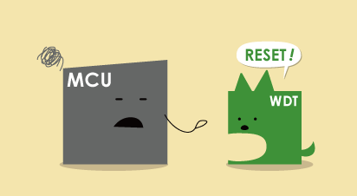
WATCHDOG TIMER

Slide 2
Watch Dog Timer
MCUs are used in all sorts of electronic devices, but whether a WDT is required or not depends on the “level of safety demanded by or deemed necessary for a specific application.”
A watchdog timer is an electronic timer that is used to detect and recover from computer malfunctions
In such systems, the computer cannot depend on a human to reboot it if it hangs; it must be self-reliant.

Slide 3
Need for watchdog timer
A watchdog timer can get a system out of a lot of dangerous situations.
In Automotive devices MCU failure or malfunction could lead to life-threatening accidents.
In water heaters and kitchen stoves, MCU failure or malfunction poses a fire risk.
However, if it is to be effective, resetting the watchdog timer must be considered within the overall software design.
Designers must know what kinds of things could go wrong with their software, and ensure that the watchdog timer will detect them, if any occur.

Slide 4
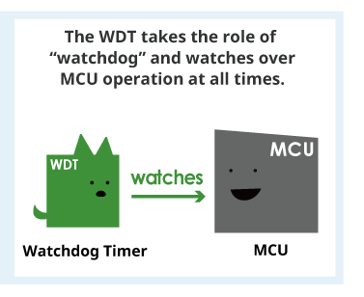
WDT operation : Detection of MCU faults
The watchdog timer communicates with the MCU at a set interval.
If the MCU does not output a signal, outputs too many signals or outputs signals that differ from a predetermined pattern, the timer determines that the MCU is malfunctioning and sends a reset signal to the MCU

Slide 5
Watchdog timer
Watchdog timer is based on a counter that counts down from some initial value to zero.
The embedded software selects the counter's initial value and periodically restarts it.
If the counter ever reaches zero before the software restarts it, the software is presumed to be malfunctioning and the processor's reset signal is asserted.
The processor (and the software it's running) will be restarted as if a human operator had cycled the power.

Slide 6
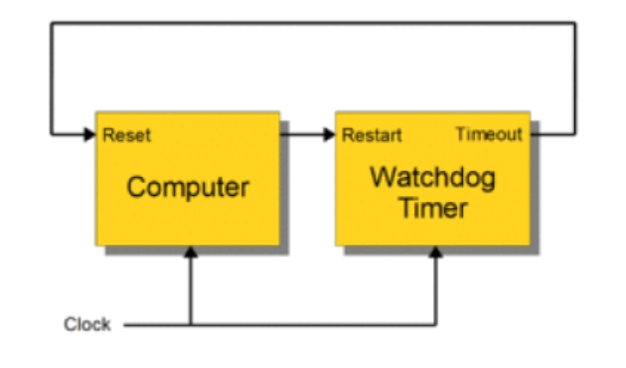
Watchdog timers come in many configurations, and many allow their configurations to be altered.
Internal Watchdog Timer
Microcontrollers often include an integrated, on-chip watchdog timer.
External Watchdog Timer
In other computers the watchdog may reside in a nearby chip that connects directly to the CPU, or it may be located on an external expansion card in the computer's chassis.
The watchdog and CPU may share a common clock
or they may have independent clock signals.

Slide 7
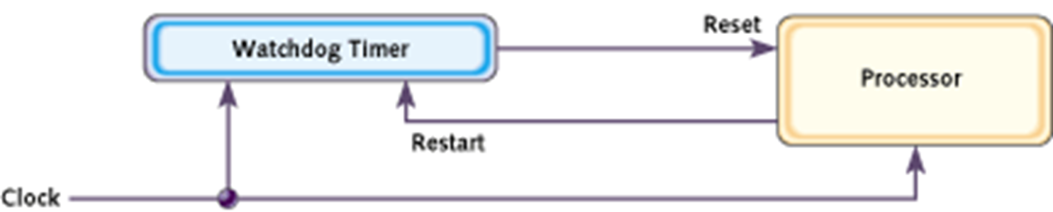
In either case, the output from the watchdog timer is tied directly to the processor's reset signal.

Slide 8
Internal Watchdog Timer
While manufacturing the microcontrollers or processors, they are designed with inbuilt watchdog timer which is enabled by the software program to detect the system abnormality functions and rectify it by system rebooting.
This type of timer automatically restarts the microcontroller and reboots the program at the starting address until successful execution of the programs.
The internal watchdog timers save money

Slide 9
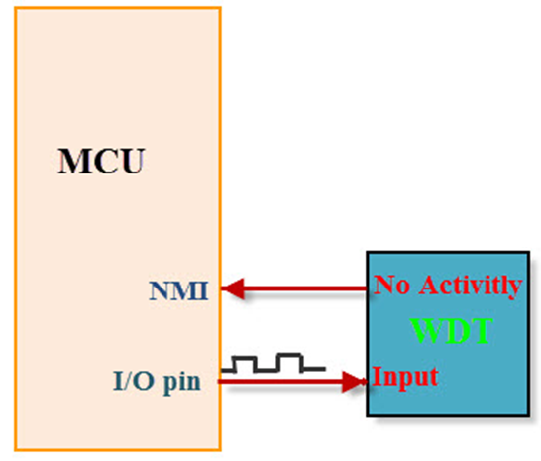
External Watchdog Timer
The external watchdog timers are enabled manually by hardware after detecting the system abnormality functions.
The external watchdog has a separate clock source given for better reliability.
High cost is a disadvantage of external watchdog timer.

Slide 10
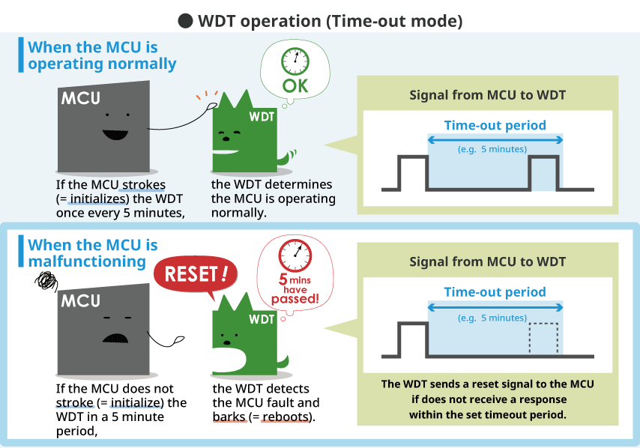
Time-out mode
In this mode, the watchdog timer determines the MCU is malfunctioning and outputs a reset signal if it does not receive a signal from the MCU within the set interval

Slide 11
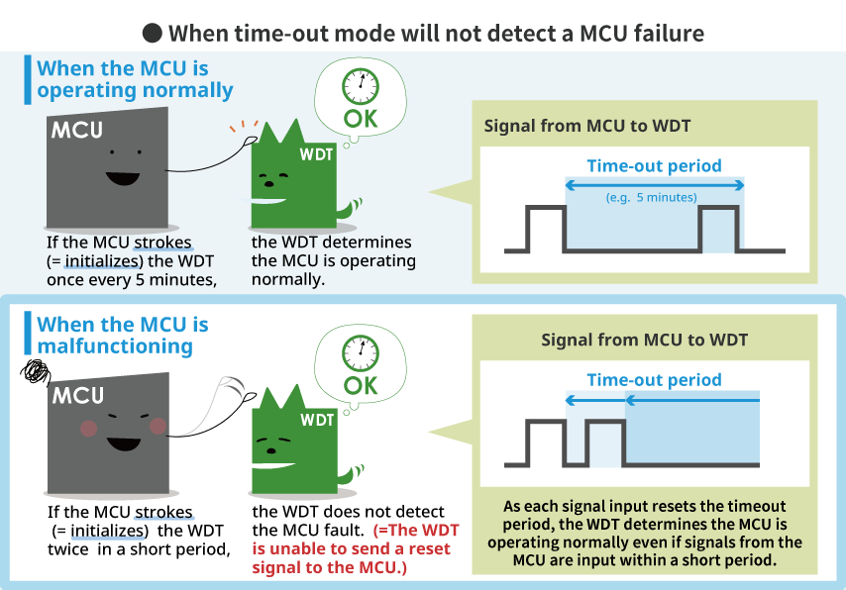

Slide 12
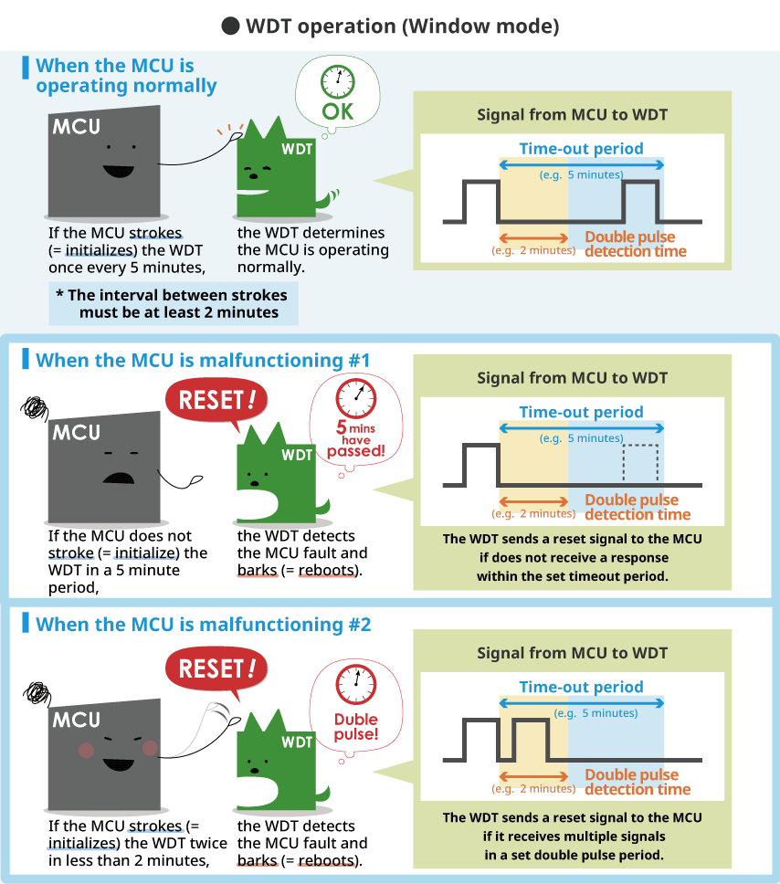
Window mode
In window mode, the watchdog timer determines that the MCU is malfunctioning and outputs a reset signal if it does not receive a signal, or receives multiple signals (= double pulse) from the MCU within the set interval.
A window mode may be more suitable for applications such as automotive devices that require greater safety.

Slide 13
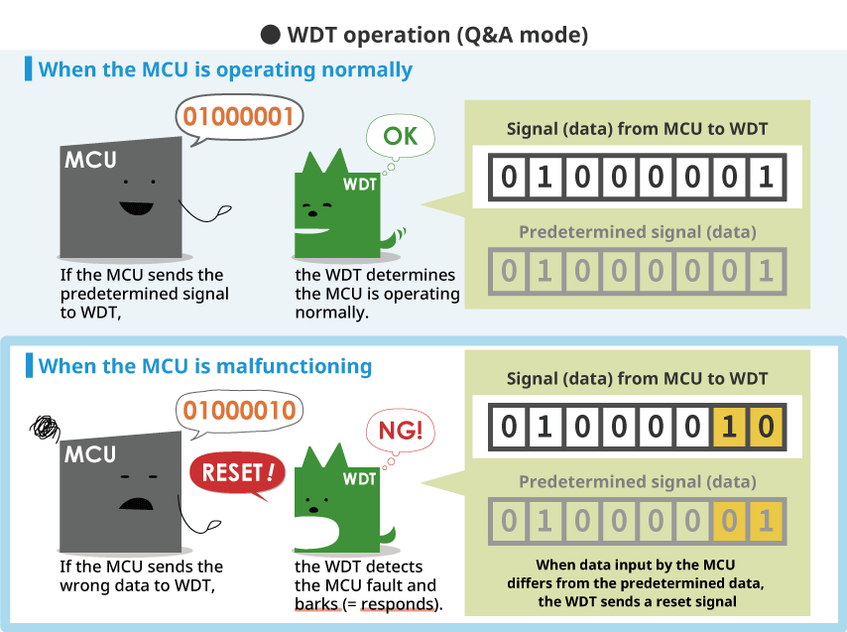
Q&A (Question & Answer) mode
The WDT determines whether or not the MCU is operating normally depending on whether or not the signal sent by the MCU matches predetermined data.
This mode relies on data communication between the MCU and WDT, which makes operation more complex.

Slide 14
What applications require WDTs?
Watchdog timers may also be used when running untrusted code in a sandbox, to limit the CPU time available to the code and thus prevent some types of denial-of-service attacks
Used to automatically detect software anomalies and reset the processor if any occurs
In systems that impact human life or in applications where malfunction of electronic control can cause serious accidents, an external WDT is required to ensure sufficient redundancy

Slide 15
Watchdog resets
In computers that are running operating systems, watchdog resets are usually invoked through a device driver.
The device driver serves to abstract the watchdog hardware from user space programs, is also used to configure the time-out period and start and stop the timer.
For example, in the Linux operating system, a user space program will kick the watchdog by interacting with the watchdog device driver, typically by writing a zero character to /dev/watchdog.

Slide 16
What errors are caught
A properly designed watchdog mechanism should, at the very least, catch events that hang the system.
In electrically noisy environments, a power glitch may corrupt the program counter, stack pointer, or data in RAM.
The software would crash almost immediately, even if the code is completely bug free. This is exactly the sort of transient failure that watchdogs will catch.
Bugs in software can also cause the system to hang, if they lead to
an infinite loop
an accidental jump out of the code area of memory
or a dead-lock condition (in multitasking situations)
an unusual number of interrupts arrives during one pass of the loop.

Slide 17
However, if it is to be effective, resetting the watchdog timer must be considered within the overall software design.
Designers must know what kinds of things could go wrong with their software, and ensure that the watchdog timer will detect them, if any occur.

Slide 18
Corrective actions
Watchdog timer may initiate any of several types of corrective action, including
processor reset
non-maskable interrupt
maskable interrupt
power cycling
fail-safe state activation, or combinations of these
In embedded systems and control systems, watchdog timers are often used to activate fail-safe circuitry.
When activated, the fail-safe circuitry forces all control outputs to safe states (e.g., turns off motors, heaters, and high-voltages) to prevent injuries and equipment damage while the fault persists

